Slide 1
MIDDLETON CHENEY
FOOTBALL CLUB

Slide 2
FIRST TEAM
1947-48
SEASON
OXFORD JUNIOR LEAGUE
AND CUPS

Slide 3
May 1st 1948
Banbury Charity Cup Final Played at Spencer Stadium
NAC 1 V 2 Middleton
A. Turvey
H. Gibbard
B. Merry
E. Watkins
L. Fortnum (Capt)
G. Merrivale Goal Scorer H. Gibbard (Pen)
G. Barnes T. Barnes
R. Christie
T. Barnes
J. Christie
S. Baker
Ref Mr J. Powell

Slide 4
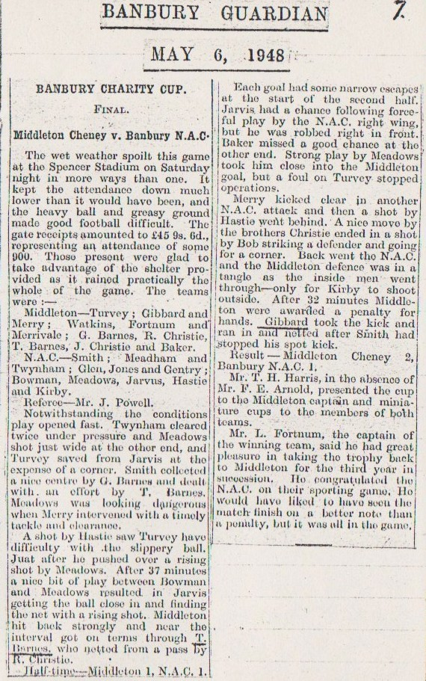

Slide 5
May ? 1948
Banbury Guardian Cup Final Played at Spencer Stadium
Shenington 2 v 1 Middleton
A. Turvey
H. Gibbard
B. Merry
E. Watkins
L. Fortnum (Capt)
G. Merrivale Goal Scorer L. Fortnum
G. Barnes
R. Christie
T. Barnes
J. Christie
S. Baker
Ref Mr F Allitt

Slide 6
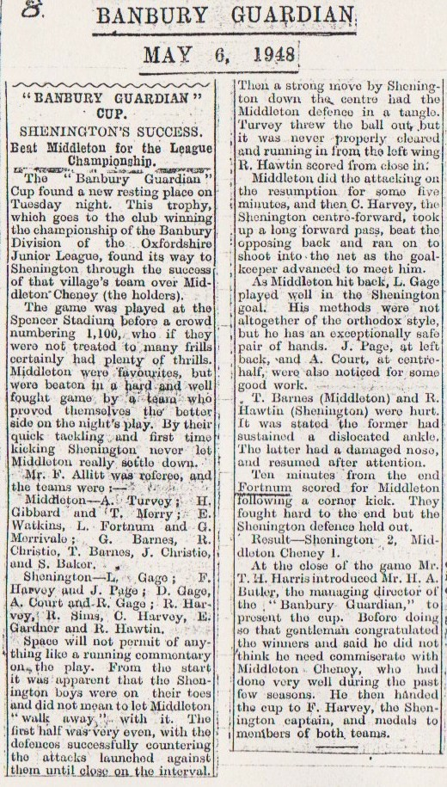

Slide 7
May 8th 1948
Brackley (Myers) Charity Cup Final Played at Brackley
Syresham 2 v 3 Middleton
A. Turvey
H. Gibbard
B. Merry
E. Watkins
L. Fortnum (Capt)
G. Merrivale Goal Scorer H. Gibbard (Pen)
G. Barnes J. Christie
R. Christie R. Christie
C. Yates
J. Christie
S. Baker
Ref Mr N A Barrick

Slide 8
